Slide 1
USFS / 18F
ePermits
April 24th, 2018
Brian Schwind, U.S. Forest Service
Aaron Burk, U.S. Forest Service
Rebecca Refoy-Sidibe, GSA 18F
Laura Gerhardt, GSA 18F
Mark Trammell, GSA 18F
Hannah Kane, GSA 18F

Slide 2
ePermits Purpose
As the first two-way interaction-focused Forest Service online application, ePermits will strengthen the connection between the public and the National Forests.
The application will broaden and increase the public’s responsible access to public lands through online availability; a predictable, responsive and friendly experience; and reduce administrative burden.
These enhancements will drive increased customer satisfaction and quality of public engagement.

Slide 3

Human-centered design
Human-centered design helps facilitate a dialogue to ensure products and services that work for everyone!

Slide 4
1/ Product Demo

Slide 5
Product Demo
Special Uses Pilot - Mt. Baker Snoqualmie
Wizard
Form fill
Admin review
Christmas Tree Pilot – Arapaho Roosevelt, Shoshone, Flathead, Mt hood
Preview

Slide 6
Special use applications
Notes:
Since the permit review process is complex, the special use module within our product really focuses on getting the application process easy and complete to minimize rework, down the line.

Slide 7
For special uses, three challenges:
Public confused by form questions.
Forest Service reviewing incomplete applications.
Applicants unclear what happens next.
Notes:
This hinders some of the desire from both the government and the public wanting:
Good Customer service
Responsible use of the forest

Slide 8
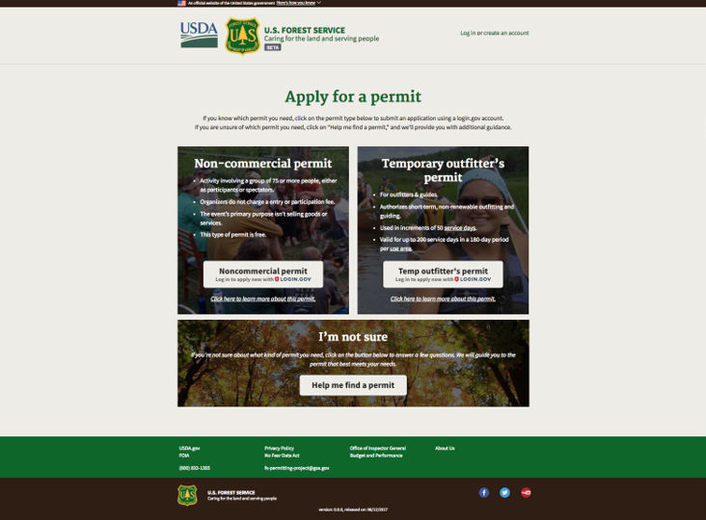
Apply for Permit
Notes:
Screen shot backup
Home page for special use applications- have
Option to choose a permit if you know what you need, but also realize that it might not be obvious to newer users so have the opportunity to go use a wizard

Slide 9
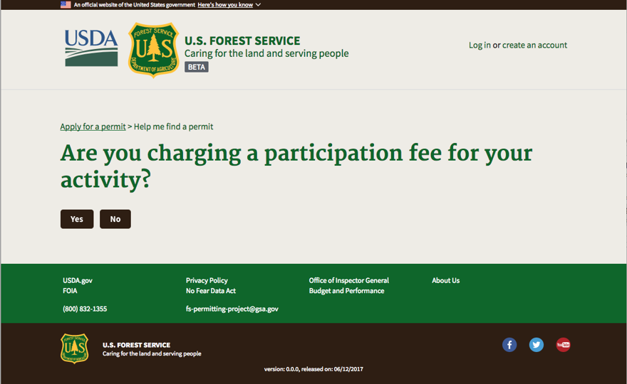
Participation Fee
Notes:
Couple of public facing oriented questions to help them figure out if they need a permit, if its offered by our site, and which permit they need.

Slide 10
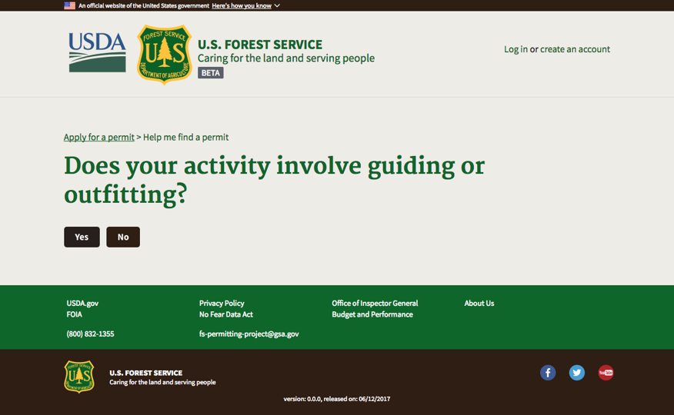
Guiding or Outfitting

Slide 11
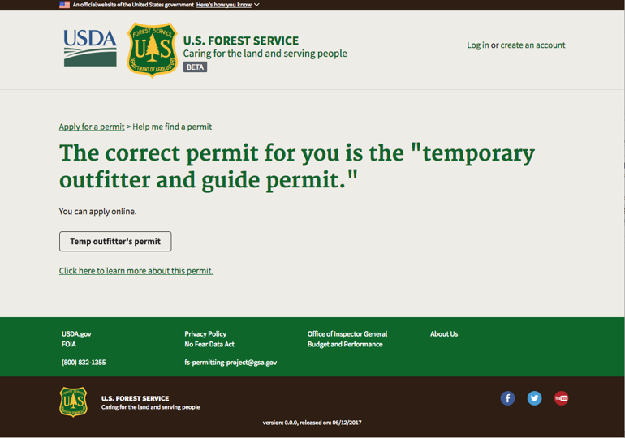
Temporary Outfitter
Notes:
Can then apply for a permit, or learn more about the permit. For now we’re going to click learn more to see a bit about the permit.

Slide 12
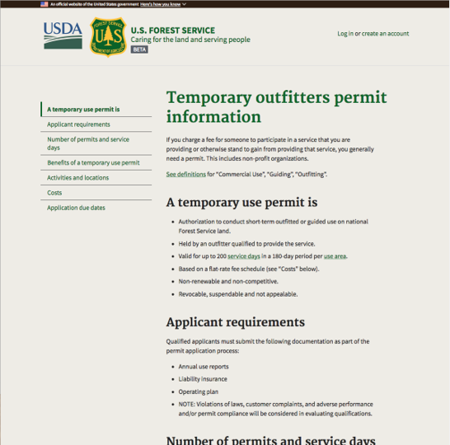
Temporary Outfitter Information
Notes:
We worked with both front-liners and applicants to update existing information and fill in a lot of the gaps so that we can improve the submissions- reducing a lot of rework and coordination that goes into the application process.

Slide 13
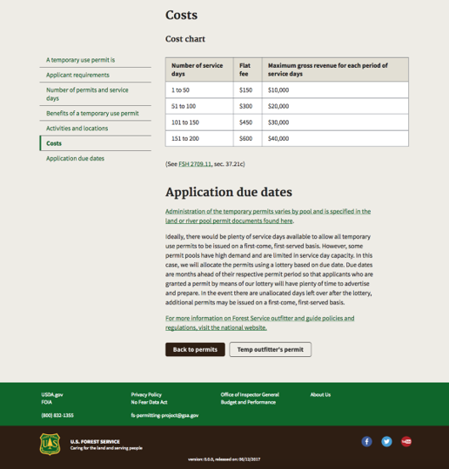
Cost Chart
Notes:
From this page, as from the wizard, or the homepage, users can click to log in to apply for a permit.
FYI - link is currently broken on 1/2/18 Bypassing for demo

Slide 14
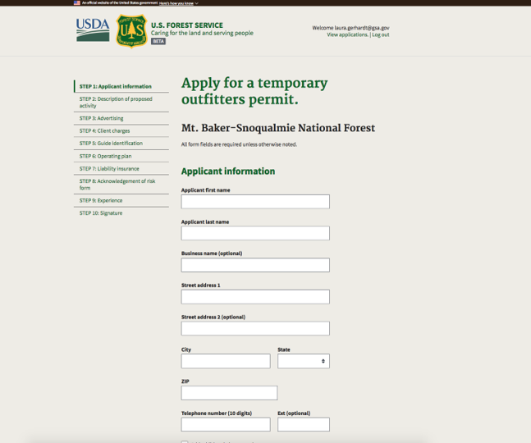
Apply for Temp Permit
Notes:
Helpful help text
File upload
Broken down bigger text chunks
Matches OMB approved form

Slide 15
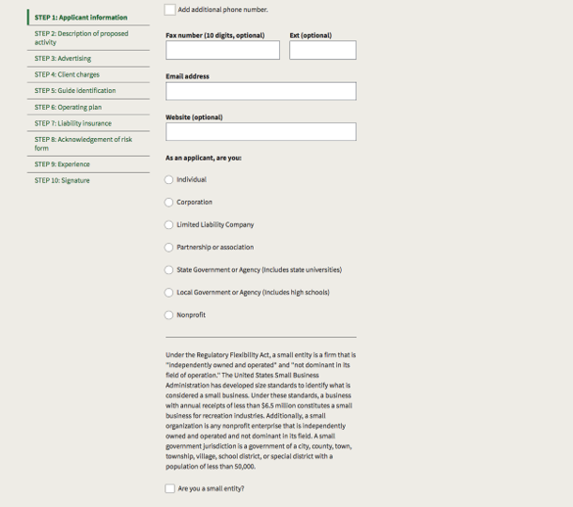
Applicant Info

Slide 16
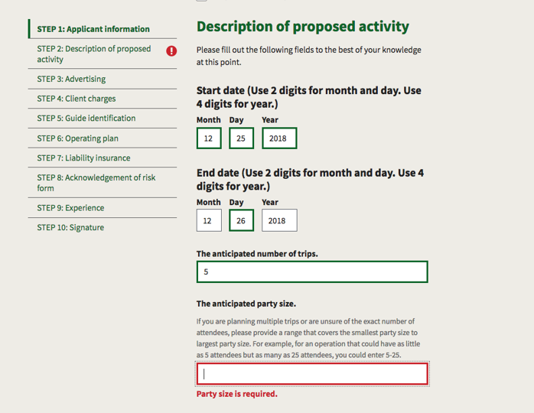
Proposed Activity Description
Notes:
Validation - to help the users figure out where they may need to jump back to and also the FS frontliners not spending time chasing down a bad phone number or vital information like party size

Slide 17
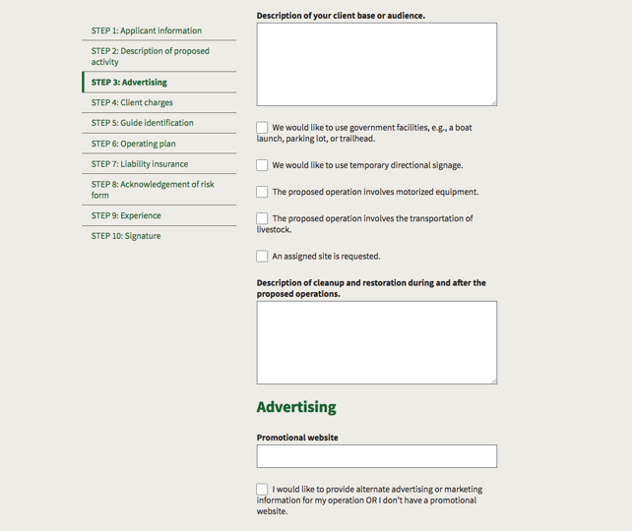
Advertising
Notes:
Broke out a large section of the paper form & coordinated developing help text so the FS can spend more time reviewing only relevant info
And the applicants don’t have to put down everything under the sun just to see it stick

Slide 18
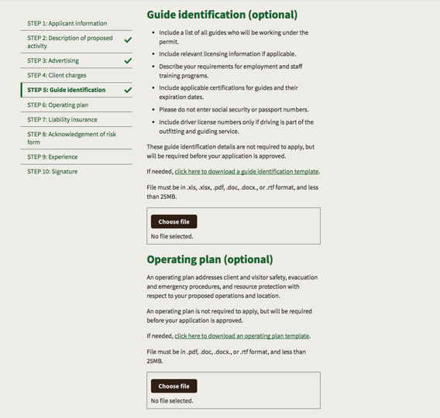
Guide Identification
Notes:
Supplemental documentation can be uploaded- creates a more complete application experience, and keeps all the information together for the fs employees reviewing

Slide 19
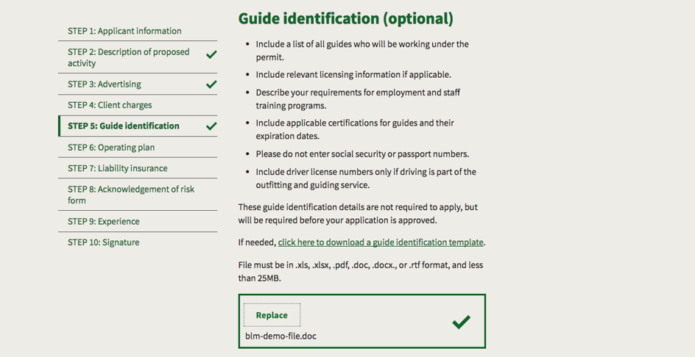
Guide ID detail

Slide 20
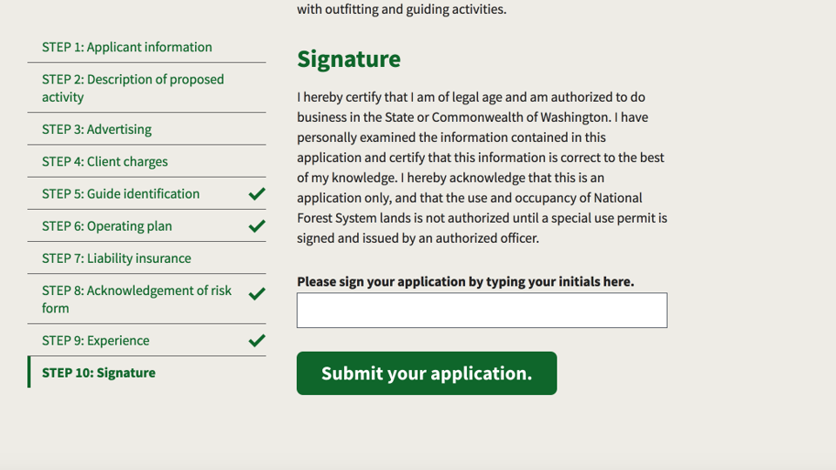
Signature
Notes:
Submit button

Slide 21
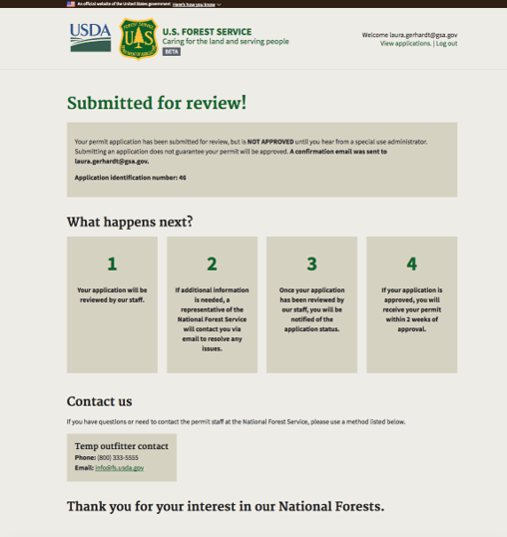
Submitted for Review
Notes:
To give more transparency about what happens next we’ve included a confirmation page that outlines what happens next

Slide 22
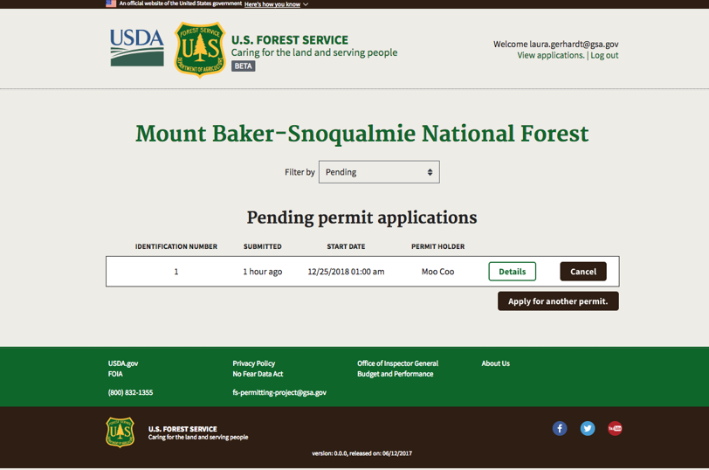
Pending Permit Applications
Notes:
And can log back in to see its status

Slide 23
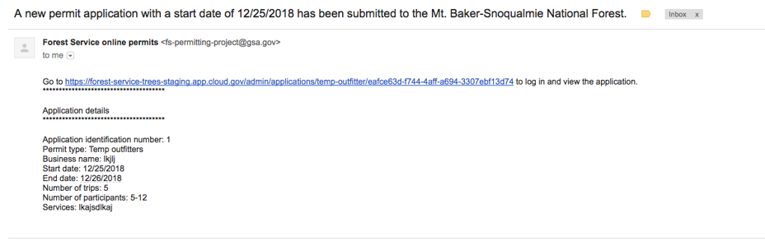
Email Confirmation
Notes:
When an application is submitted, special use administrators recieve an email that a new application has been recieved. They can also take a look at this list. The applicants themselves, can view a similar display of just the applications that they themselves have submitted.

Slide 24
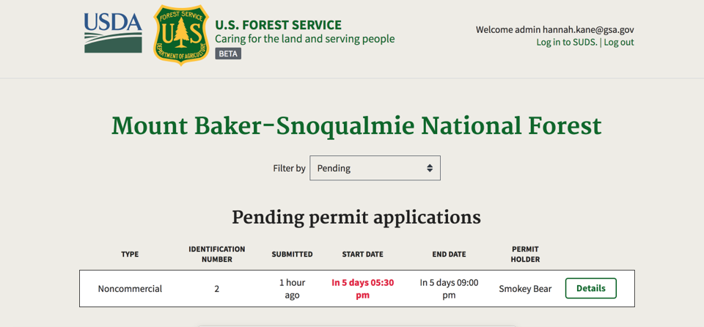
Start Date for permit
Notes:
The FS then also has a view of what pending applications

Slide 25
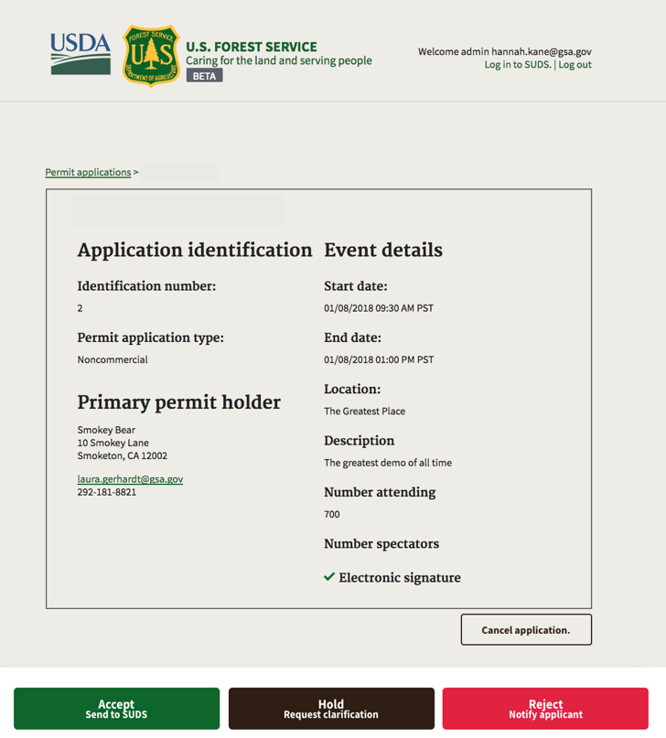
Application ID details
Notes:
Can click to review the information - and the associated files of the application. And make an intial determination - to move it to the next step, ask for more clarifcation or reject it.

Slide 26
Christmas Tree Permits
Notes:
Unlike the special use permits, which require fs review to make sure they comply with NEPA and other relevant regulations, the xmas tree permit module focuses on creating an informative, self-service permit issuer.

Slide 27
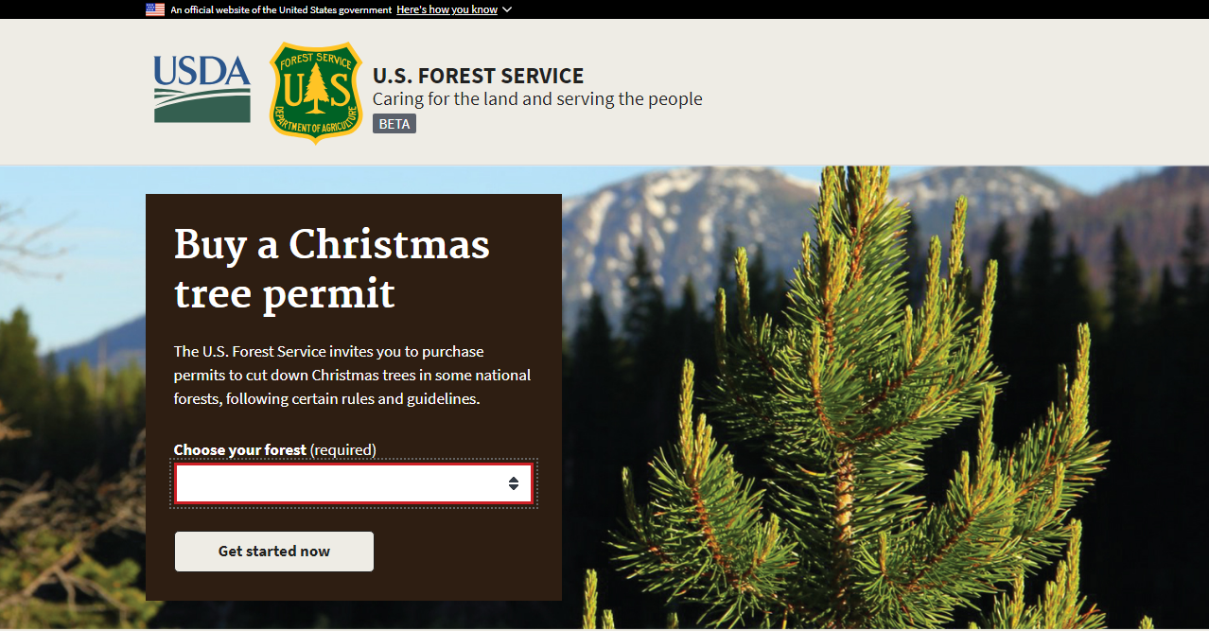
Find a Forest
Notes:
Option to view forest maps - likely be revisted as we onboard more forests

Slide 28
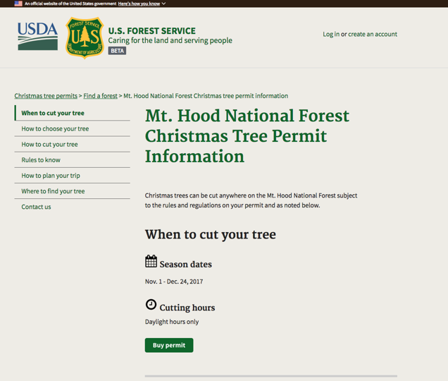
When to Cut Your Tree
Notes:
Like SU, we povide helpful information about when, where and how to cut a tree. We found from our research that the current in person transactions were fast and easy - but that the frontliners conveyed a lot of important information when handing over a tag- so we focused a lot on making sure that knowledge was captured back into the content areas of the site.

Slide 29
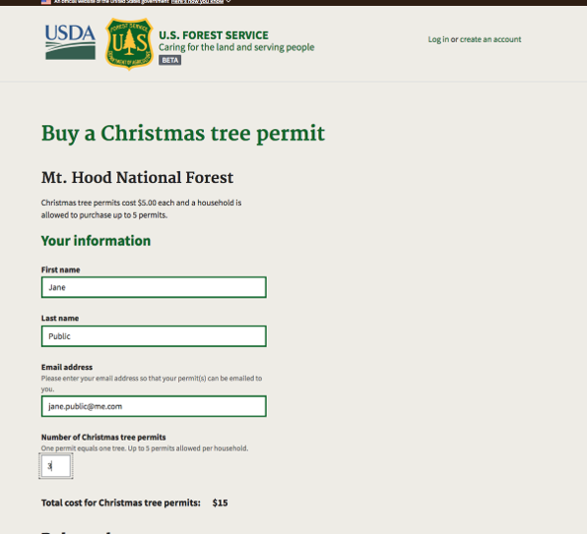
Buy a Christmas Tree Permit
Notes:
Automatically calculates your total cost - like many people come to expect

Slide 30
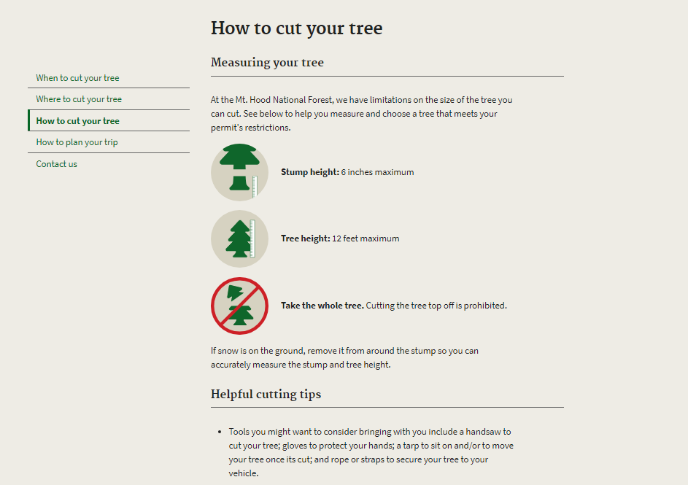
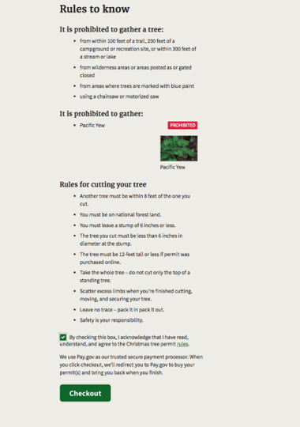
Rules to Know
Notes:
Have to check you’ve read it before you can go on

Slide 31
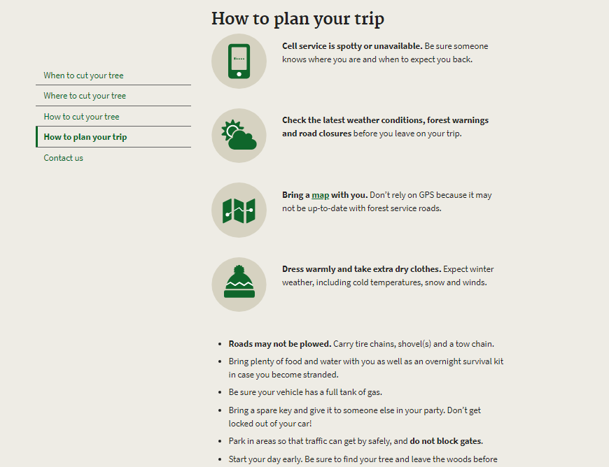

Slide 32
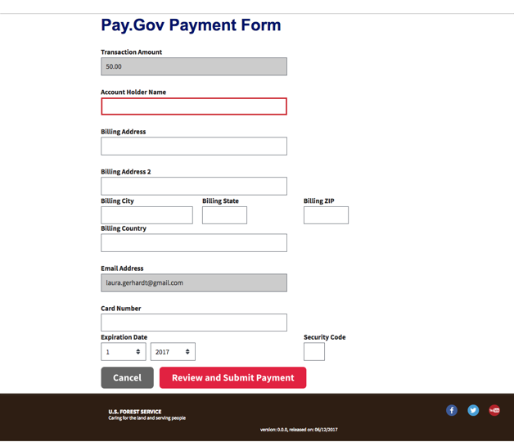
Pay.gov Form
Notes:
Users will complete their purchase using the US. Treasury’s pay.gov - Will be actual pay.gov but we are currently waiting for treasury to create a test environment for us.
If you are not familar - pay.gov is like the paypal for the government - it allows us to process payments easily. In particular, we learned that the payment process requires a lot of manual processing, and this elminates that work for permits purchased through epermit
Changed the styling in browser for this - even though it doesn’t actually look like this in the application

Slide 33
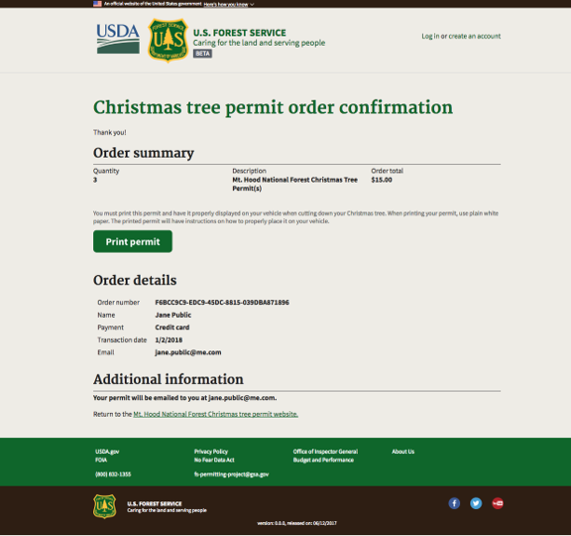
Christmas Tree Permit Confirmation
Notes:
Upon successful completion of payment, they’ll be redirected back to the site and see a confirmation page, where they can see the summary of their order and then can print their permit.

Slide 34
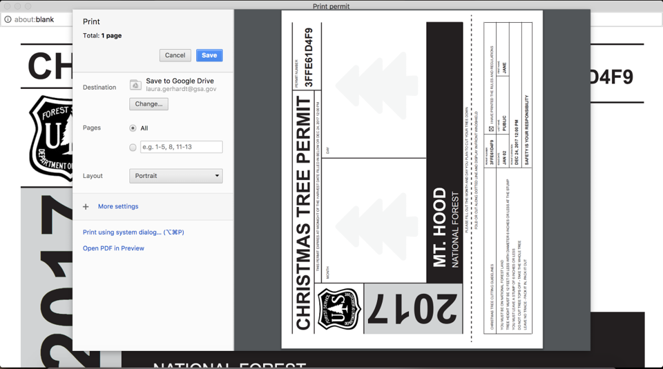
Print Permit
Notes:
By clicking on the button, then they can then be directed to a new page which will trigger the print function.
They are instructed to print this out and then place this on their car dashboard.
They are also emailed this info so that they could print it out later

Slide 35
Accomplishments and Implementation
Recent
Cloud Cybersecurity authroization
Initial Special Use ePermit complete
Christmas Tree ePermit development complete
Internal and external user system testing
Upcoming
ePermit Cybersecurity authorization – May/June 2018
Begin testing Special Use ePermit on Mt. Baker Snoqualmie – April/May 2018
ePermit Implementation Plan
USDA eBoard June 2018

